Slide 1
COMP7212 Operating/Distributed Systems
Introduction
Dr. Myounggyu Won

Slide 2
Instructor
Myounggyu Won, Ph.D.
Email: mwon@memphis.edu
  You can also email via Canvas
Office: DH398
Office Hours: MW 3:45PM-5:00PM and by appointment
Check regularly Canvas for announcements!
  HW Q/A, Tips, Corrections, etc.
  Exam Reviews.
  Attendance.
  In-class exercise.
  And many more…

Slide 3
TA
Manish Kasu (mjkasu@memphis.edu)
Duties
  Grade your programming projects.
  Grade your written assignments.
  Grade your quiz/in-class exercises.
  Answer questions about assignments.

Slide 4
Pre-requisites
COMP 2150 Object-Oriented Programming and Data Structures and COMP 3410 Computer Organization & Architecture
or Permission of instructor

Slide 5
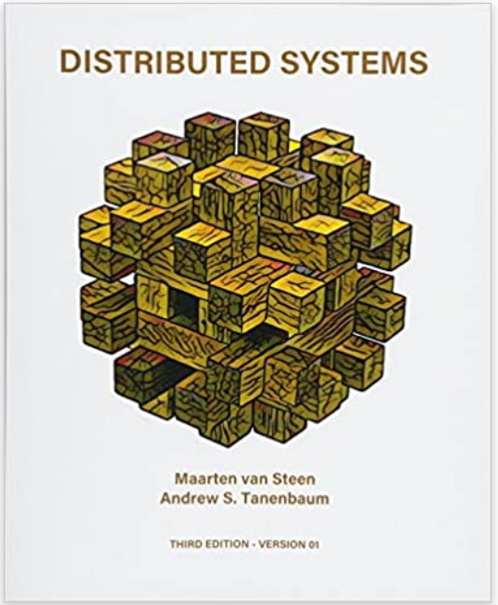
Textbook
Distributed Systems: Principles
and Paradigms (3rd Edition), Andrew
S Tanenbaum and Maarten Van
Steen
ISBN: 978-0132392273

Slide 6
Course Policy
Attendance
    There will be 15 in-class exercises worth a total of 150 points, which can significantly impact your final letter grade if performed well.
    I have seen many students who got an ‘A’ even if he/she did not do well in their exams because they actively participated in the in-class exercises and received full marks.
  Responsible for materials covered during class, and quizzes/in-class exercises

Slide 7
Course Policy
Assignments
  Due at 11:59PM on the due date
  20% off each day after the due date
  No credit for assignments submitted after 5 days
    Submit incomplete work for partial credits
  Submit your incomplete work for partial/base credits
    If you submit nothing, you will get 0 points.

Slide 8
Course Policy
Academic Integrity/Plagiarism
  Do not copy from another student’s work
  Do not copy from the Internet
  Do not give your work to other students
If plagiarism or cheating occurs, the student will receive a failing grade on the assignment.
For more info, refer to http://www.people.memphis.edu/~jaffairs/

Slide 9
Course Goals
The student will be able to identify basic roles of distributed systems.
The student will be able to list the various components of distributed systems.
The student will be able to identify major issues in the design of distributed systems.
The student will be able to analyze the tradeoffs involved in the design of distributed systems.

Slide 10
Paper Presentation
A presentation schedule will be determined by the instructor (in an alphabetical order of last name).
  Students are not allowed to change the presentation schedule. If a student fails to present a paper on the scheduled date, they will automatically receive a zero.
A student's presentation must include the following minimum content. Additional details may be incorporated at the student's discretion, provided the presentation does not exceed the 30-minute time limit.
Introduction (1 slide)
  What is the problem?
  Why is the problem important?
  What is the key idea to solve the problem?
  Why is the problem hard? (i.e., what are the challenges addressed in the paper)
Related Work (1 slides)
  Discuss two related papers including the main idea and limitation compared to the paper you are presenting.
Proposed Approach/Ideas (5+ slides)
  Overview (before presenting the details, show us the big picture of the proposed idea).
  And then, the details.
Experimental Results (2~3 slides)
  No need to present all results.
  Choose two to three graphs/tables that represent the key results.
Conclusion (1 slide)

Slide 11
Expected Performance Criteria
Programming Assignments (3) | 200
Written Assignments (3) | 100
Quizzes/In-class Exercises (15) | 150
Paper Presentations | 100
Midterm 1 | 100
Midterm 2 | 100
Final Exam | 150
Total Points Possible | 900

Slide 12
Course Overview
Chapter 1. Introduction
  What is a distributed system?
    Characteristics, middleware, …
  Design goals
    Resource sharing, transparency, openness, scalability
  Types of distributed systems
    High performance, distributed information, pervasive
Chapter 2. Architectures
  Architectural styles (software)
    Layered, object-oriented, …
  Middleware organization
  System architecture (hardware)
    Centralized (client-server)
    Decentralized (peer-to-peer)

Slide 13
Course Overview
Chapter 3. Processes
  Threads
    Multithreaded clients
    Multithreaded servers
  Virtualization
    Hide the complexity/diversity of systems by exposing a virtualized interface
  Clients/Servers
    More details on the design of client/server processes

Slide 14
Course Overview
Chapter 4. Communication
  Remote procedure call
  Message-oriented communication
    Numerous issues on message-based communication
  Multicast communication
    Tree-based
    Flooding-based
    Gossip-based

Slide 15
Course Overview
Chapter 5. Naming
  Basic concepts
    To access service, data, etc., we need to give a name to an entity
  Flat naming
    Unstructured name (i.e. random bit strings)
  Structured naming
    Simple, human-readable names
  Attribute-based naming
    A description of an entity in terms of (attribute, value)

Slide 16
Course Overview
Chapter 6. Coordination
  Clock synchronization
  Logical clocks
    Order of events rather than the exact time
  Mutual exclusion
    Coordinate access of processes to resources
  Election algorithms
    Electing a coordinator
  Location algorithms
    For a large-scale distributed systems, location information is important
  Distributed event-matching algorithms
    For publish-subscribe systems, an event should be matched to systems subscribed to the event

Slide 17
Course Overview
Chapter 7. Consistency and Replication
  Replication for enhancing reliability and improving performance
  Consistency: when one copy is updated, the others should be updated as well
    Data-centric consistency models
    Client-centric consistency models
  Replica management
    Where, when, and by whom replicas should be placed?
  Consistency protocols
    Actual implementation of consistency models

Slide 18
Course Overview
Chapter 8. Fault Tolerance
  Process resilience
    Automatic recovery from failures
  Reliable client-server communication
  Reliable group (multicast) communication
  Distributed commit
    A group of processes either jointly commit their local work, or collectively abort.
  Recovery
    How to recover from failure?

Slide 19
Good luck!

